Slide 1
BUILDING FORM DEVELOPMENT PLAN
A report shall be prepared on the evolution of the form of the building based on
Science of architecture
Climatology
Building physics.
The plan shall be in line with the decision making process of the project team and a narrative shall be prepared briefly mentioning the justification behind the following points to ensure that the final design meets with the intent of this Part.
The selected building form and
Orientation of the building and
Shading devices

Slide 2
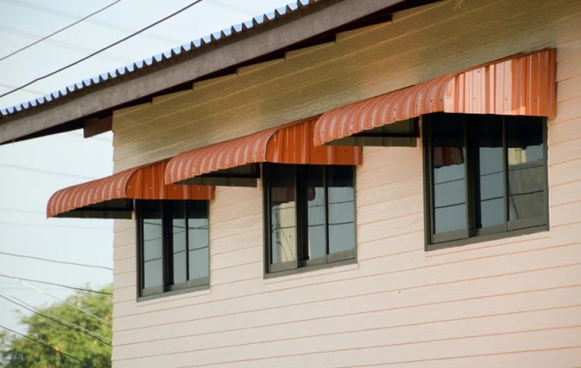
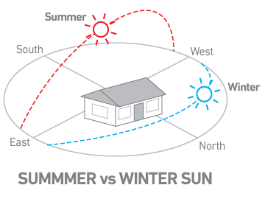
BUILDING FORM, ORIENTATION AND SHADING
The development shall plan on locating, orienting & shading the building so that,
There is adequate provision for external shading of the facades during the peak summer season
There is adequate provision for vertical shading to prevent direct solar radiation and glare due to low altitude sun angles, specifically on the eastern and western facades
The building is oriented optimally based on sun-path and engineering analysis and
There is adequate protection for the building envelope against thermal losses, drafts and degradation by natural elements such as wind, dust, sand, snow, rainwater, hail, etc.

Slide 3
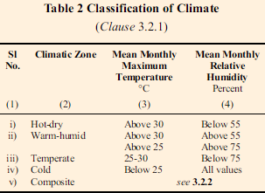
Windows facing north or south provide good access to illumination & effortless shading
Above strategies shall be implemented based on the climatic conditions of the location.
Specifically, the designs should be based on the heating degree days and cooling degree days of the actual location of the building.
In the absence of this data, a more generalist approach based on the five climatic zones of the country may be used.
Building orientation and shading studies should carry out and establish the optimal building orientation for the project and ensure appropriate shading design.
Solar path analysis shall be done for obtaining optimum form and orientation for the building.
A design report showing both the optimum orientation and shading design strategies along with justification for the selection of the same shall be prepared.

Slide 4
ENVELOPE OPTIMIZATION
BUILDING FABRIC: Elements and components of a building other than furniture and the services installations. (Ex: walls, floors, roof, windows and doors.)
BUILDING ENVELOPE OPTIMIZATION: It refers to the process of designing and improving the exterior shell of a building (its walls, roof, windows, doors, and foundation) to achieve maximum performance in terms of energy efficiency, comfort, durability, and sustainability.
BUILDING ENVELOPE:
The building envelope acts as the interface between indoor and external climatic conditions. It potentially regulates the building climatic response.
The building envelope should be designed to conserve energy substantially.
Well designed building envelope
Maximizes daylight
Maximizes natural ventilation (fresh air) and views to the exterior
Enables to modulate solar heat gain and control/reduce noise

Slide 5
The building envelope may also be designed to integrate systems for renewable
energy and rainwater harvesting.
In general, the design strategies drawn from long experience in the country in its various climatic zones may be taken into account. A well-design building envelope eliminates the entry of contaminated air and moisture.
Building envelope components and their configuration largely determine
The amount of heat gain or loss
Wind that enters inside the building
Extent of natural ventilation in the building
Primary components of building envelope which affect the performance of a building are,
Fenestration (Doors, Windows, Openings with or without glazing)
Walls
Roof (Including skylights and clerestories)
Floor and surface finishes.

Slide 6
a) WINDOWS AND DOORS
Many design features and technologies make windows more energy efficient and improve the durability, aesthetics, and functionality.
The factors which influence the overall energy-related properties of the window are
Frame materials
The glazing or glass features
Gas fills and spacers
The type of operation
Frames and Sash
Improving the thermal resistance of the frame can contribute to a window's overall energy efficiency, particularly its heat loss rate or U-factor.
There are advantages and disadvantages to all types of frame materials, but vinyl, wood, fiberglass, and some composite frame materials provide greater thermal resistance than metal.

Slide 7
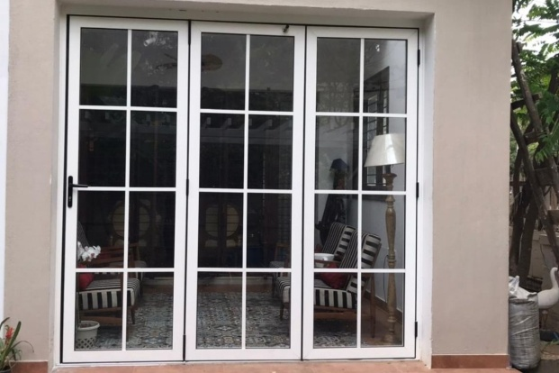
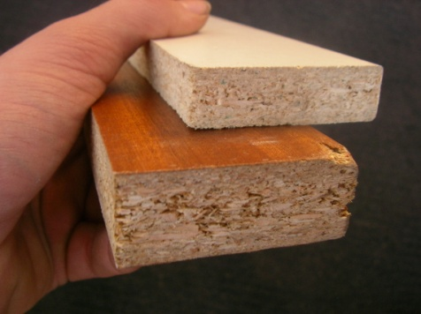
TYPES OF FRAMES:
1. Aluminum or Metal Frames:
Very strong, light, and almost maintenance free, metal or aluminum window frames conduct heat very rapidly, which makes metal a very poor insulating material.
To reduce heat flow, metal frames should have a thermal break -- an insulating plastic strip placed between the inside and outside of the frame and sash.
2. Composite Frames
Composite window frames consist of composite wood products, such as particleboard and laminated strand lumber, and some are mixed with polymer plastics.
These composites are very stable, they have the same or better structural and thermal properties as conventional wood, and they have better moisture and decay resistance.

Slide 8
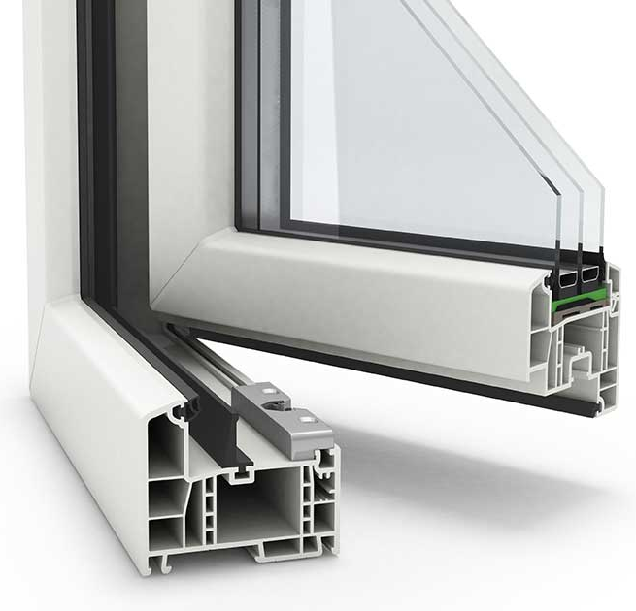
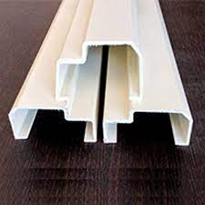
3. Vinyl Frames
Vinyl window frames are made of polyvinyl chloride (PVC) with ultraviolet light (UV) stabilizers to keep sunlight from breaking down the material.
Vinyl window frames do not require painting and have good moisture resistance. The hollow cavities of vinyl frames can be filled with insulation, which makes them thermally superior to standard vinyl and wood frames.
4. Fiberglass Frames
Fiberglass window frames are dimensionally stable and have air cavities that can be filled with insulation, giving them superior thermal performance compared to wood or uninsulated vinyl.

Slide 9
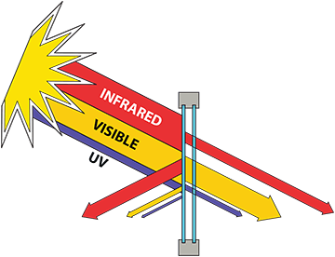
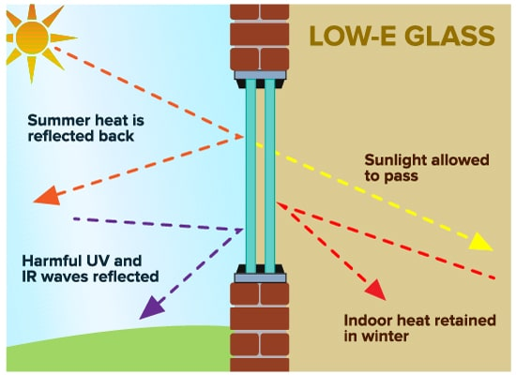
2. Low-Emissivity Coatings:
Low-E Coatings on glass control heat transfer within the insulated glazing. Windows with low-e coatings cost 10% to 15% more than regular windows, but they reduce energy loss by as much as 30% to 50%.
A low-e coating is a microscopically thin, virtually invisible, metal or metallic oxide layer deposited directly on the surface of one or more of the panes of glass.
The low-e coating lowers the U-factor of the window, and can manage the daylight transmittance as well as the solar heat gain through the glazing system.
Different types of low-e coatings have been designed
High solar gain,
Moderate solar gain, or
Low solar gain, and
Tuned visible daylight transmission.

Slide 10
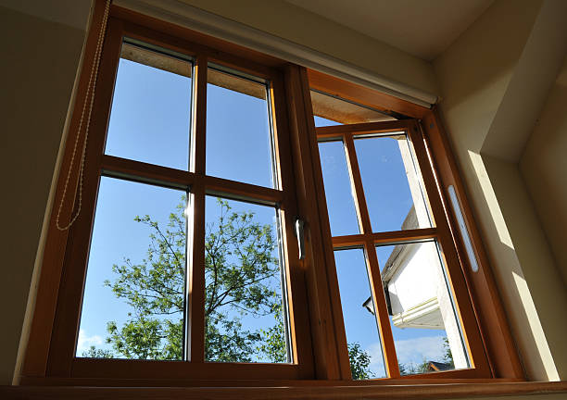
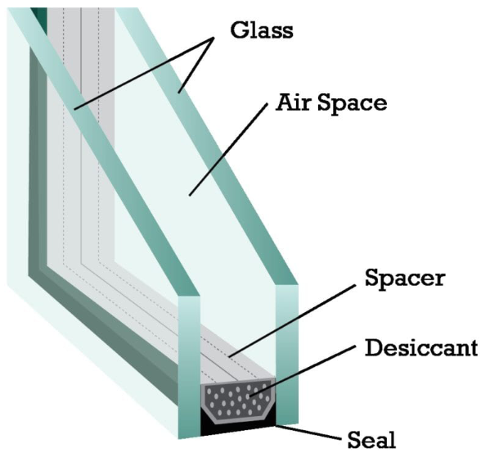
5. Wood Frames
Wood window frames insulate relatively well, but they require regular maintenance, although aluminum or vinyl cladding reduces maintenance requirements. Metal clad wood frames may have slightly lower thermal performance.
TYPES OF GLASS:
1. Insulated
Insulated window glazing refers to windows with two or more panes of glass. To insulate the window, the glass panes are spaced apart and hermetically sealed, leaving an insulating air space. Insulated window glazing primarily lowers the U-factor, but it also lowers the SHGC (Solar Heat Gain Coefficient).

Slide 11
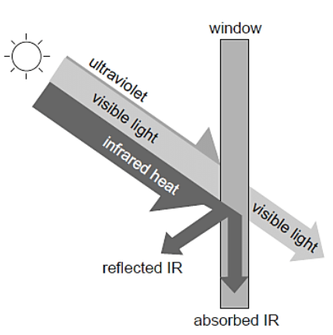
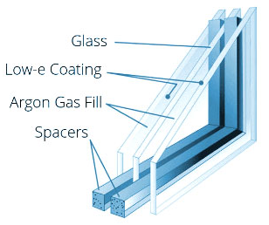
3. Spectrally Selective Coatings
In those climate where cooling loads dominate, we want a glazing that provides daylight and view but transmits as little of the sun's non-visible infrared radiation as possible, Some low-E coatings are designed to be spectrally selective, filtering out 40% to 70% of the heat normally transmitted through insulated window glass or glazing while allowing the full amount of daylight.
4. Gas Fills and Spacers
To minimize heat transfer between the interior and exterior of the window, the space between glazing layers, usually about 1/2", is filled with argon or krypton gas; both are inert, non-toxic, clear, and odorless.
Argon is commonly used, as it is inexpensive and performs well in typical 1/2" space. Krypton can be used when the space in thinner than usual - usually about ¼ inch. It has better thermal performance than argon but is also costly.

Slide 12
ENERGY EFFICIENT DOORS:
To make these doors even more energy-efficient, consider the following:-
Proper Insulation: Look for doors with high insulation values (R-values)
Weather-stripping & sealing: Prevent drafts and air leaks.
Low-E Glass: (Low-E) coatings to reduce heat transfer.
Multi-Point Locks: Better security and help seal the door more tightly.
Energy Star Certification: Look for doors with the Energy Star label.
Thresholds and Sweeps: Threshold seals and door sweeps prevent air leakage.
Professional Installation: It is crucial for maximizing energy efficiency.

Slide 13
1. Fiberglass Doors: (U-value: 1.0 to 3.0 W/m²k)
Advantages:
Excellent insulation properties, reducing heat transfer.
Resistant to warping, cracking, and rotting.
Low maintenance; they don't require painting.
Good for extreme weather conditions,
Durable and long-lasting.
Disadvantages:
Can be more expensive than some other materials.
Limited design options compared to wood.
2. Wood Doors: (U-values: 2 to 4 W/m²k)
Advantages:
Natural insulation properties.
Classic and aesthetically pleasing.
Can be customized with various designs and finishes.
Good for traditional or historic homes.
Disadvantages:
Prone to warping, cracking, and rot without proper maintenance.
Regular painting or staining required.
Not as energy-efficient as some other materials.

Slide 14
3. Steel Doors: (U-value: 3.5 to 6.0 W/m²k)
Advantages:
Strong and durable.
Excellent security features.
Energy-efficient when properly insulated.
Low maintenance; resistant to rot and pests.
Disadvantages:
Susceptible to dents and scratches.
Can be cold to the touch in extreme cold weather without proper insulation.
Limited design options.
4. Vinyl Doors: (U-value: 1.5 to 2.5 W/m²k)
Advantages:
Good insulation properties.
Low maintenance; no painting or staining needed.
Resistant to moisture, pests, and rot.
Affordable option.
Disadvantages:
Limited design choices.
May not have the same aesthetic appeal as wood or fiberglass.
Can fade or become brittle over time with exposure to extreme sunlight.

Slide 15
5. Composite Doors: (U-value: 2 to 3.5 W/m²k)
It is a combination of materials, often including wood, fiberglass, and foam insulation.
Advantages:
Excellent insulation properties.
Durable and resistant to warping, cracking, and rot.
Can mimic the look of wood while offering better insulation.
Disadvantages:
Can be more expensive than some other materials.
Limited design options compared to wood.
Susceptible to fading or discoloration in extreme sunlight.
6. Glass Doors (Double Glazed or Triple Glazed): (U-value: 0.7 to 2.8 W/m²k)
Advantages:
Good natural light and aesthetic appeal.
Excellent insulation when double or triple glazed.
Energy-efficient if properly insulated.
Disadvantages:
Poor insulation if not double or triple glazed.
Less privacy and security compared to solid doors.
Can be expensive, especially with high-quality glazing.

Slide 16
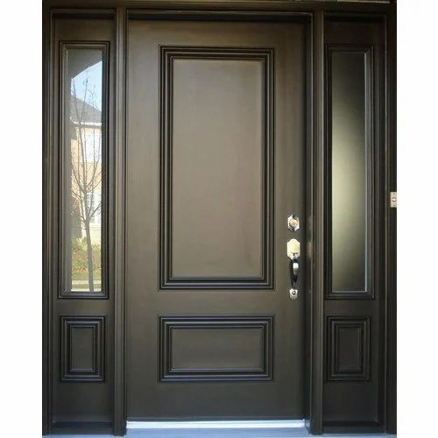
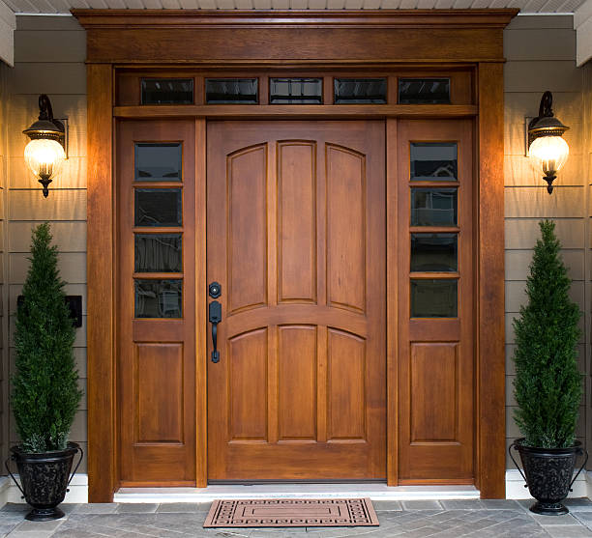
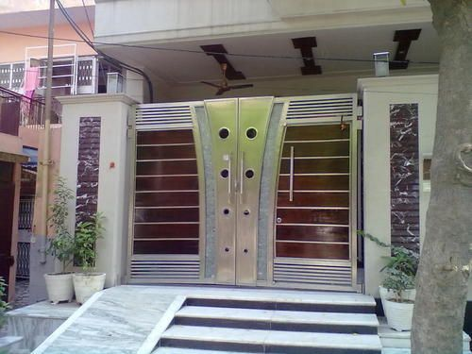
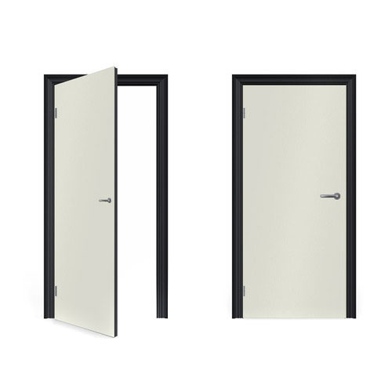
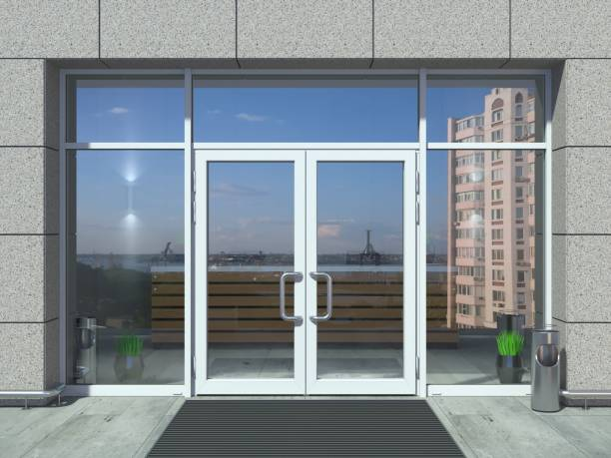
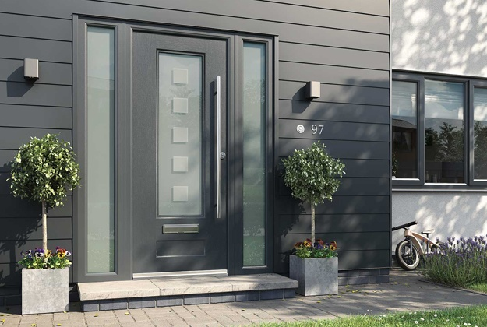
Fibreglass Door Wooden Door Steel Door
Vinyl Door Glass Door Composite Door

Slide 17
b) WALLS
Walls are a major part of the building envelope, which are exposed to the external environment conditions such as solar radiation, outside air temperature, wind and precipitation e.t.c.
The construction of wall and thereby its heat storing capacity and heat conduction property has a major impact on indoor thermal comfort in naturally ventilated buildings and on cooling loads in air conditioned buildings.
The wall material, thickness, finishes should be selected according to climate zone and building’s comfort requirement.
Wall properties that determine heat transfer are thermal conductivity, thermal resistivity, thermal absorptivity, emissivity, thermal reflectivity and thermal capacity

Slide 18
Enhancement of Thermal Performance of Walls:
Thermal performance of walls can be improved by following ways:
Thermal insulation (Applying insulation on wall surface):
Insulation plays an important role in reducing the thermal conductance of walls.
The effect of insulation is to reduce heat gain and heat loss.
Insulation should always be placed on the hotter side of the surface.
In hot climate zone, insulation should be placed on the external side of wall composition.
Insulation also controls the interior mean radiant temperature (MRT) by isolating the interior surfaces from the impacts of exterior conditions.
Insulation along with infiltration control is important for reducing heating and cooling loads in simple occupancy (skin) load dominated buildings such as residences.

Slide 19
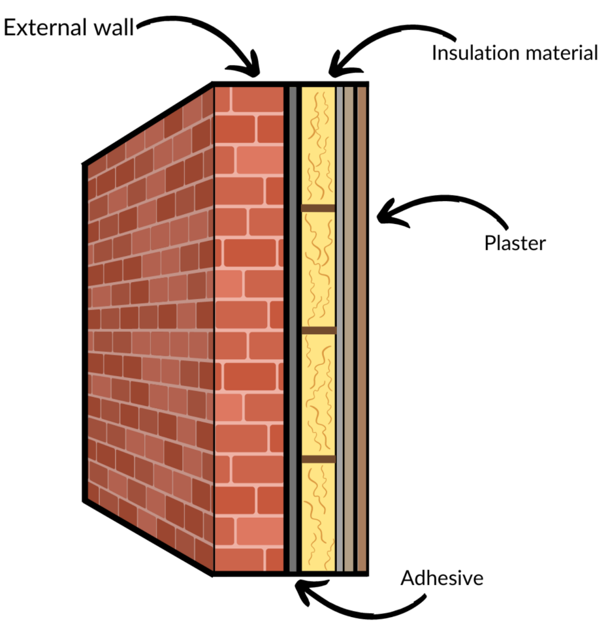
In buildings, that are internal load dominated such as offices with high equipment load, the insulation thickness and properties should be determined based on thermal performance analysis including the role of insulation in reducing cooling energy consumption, particularly in hot and dry, composite and warm humid climates.
Thermal insulation may be made from a variety of materials and in several forms.
Examples of insulation materials are Polyurethane Foam, Glass wool, Mineral wool, Cellulose insulation, Spray foam e.t.c.
Notes:
U

Slide 20
Insulation materials are divided into following five categories:
Rigid or semi rigid blocks and boards (Ex: mineral wool, expanded polystyrene boards)
Boards with impact or weather resistant surfaces suitable as exterior grade material
Loose fill (Such as, cellulose, fibre glass)
Foam and dry spray (Such as, polyurethane or polyisocyanurate) and
Blankets, felts or sheets (Ex: fibre glass, mineral wool, closed cell flexible elastomeric foam).
When specifying insulation, its key properties such as thickness, density, thermal resistivity/ thermal conductivity value at specified temperature, long term thermal retention, fire resistance, moisture resistance (structure open/ closed cell), water vapour diffusion resistance, etc, should be specified.
Insulation should be applied as per manufacturers recommendations and in a manner so that it achieves rated insulation in terms of thermal resistance or R-value.

Slide 21
ii. Thermal mass (Increasing wall thickness):
Thermal mass enables time delay in impact of external environment on internal conditions.
Thermally massive walls have high thermal capacity, which increases by increasing following
Compactness
Density and
Specific heat capacity of the materials
Walls (and other building elements such as roof and floor) can be used for thermal storage.
The effectiveness of storing heat or coolness can be increased by creating a flow of fluid through the storage media.
Thermal mass is particularly effective in hot- dry climate with larger diurnal range.
The building mass stores heat during daytime when outside temperature is high, and releases it to the inside space during night when outdoor temperature is cooler.

Slide 22
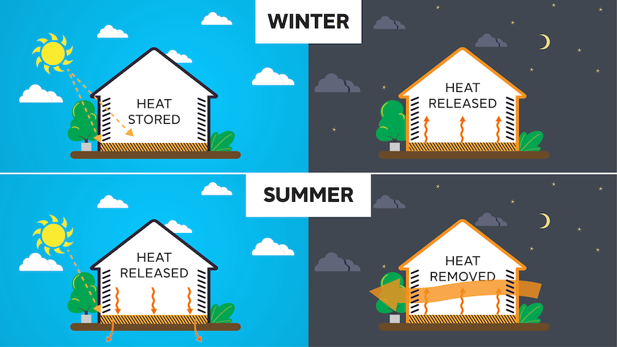
Thermal mass is also used in storing heat during daytime in cold climates, to release
it into the space during night, to warm it up when outdoor conditions are colder.
Materials such as concrete, brick and water have high thermal storage capacity and can be used for such application.
Storage mass exposed to direct sunlight should be dark in colour to allow larger absorption.
It is usually more efficient to have thicker rather than thinner storage mass.
The optimum thickness varies between 100 mm and 200 mm.

Slide 23
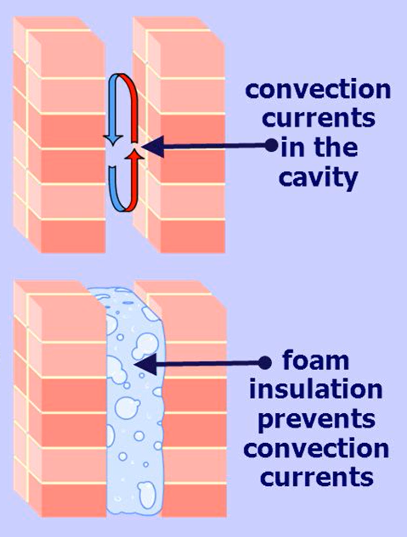
iii. Air cavities (Providing air cavities in walls) :
Air cavities in wall reduces heat gain factor.
Performance is improved if the cavity is ventilated.
Heat is transmitted through the air cavity by convection and radiation process.
Cavity represents resistance that is not proportional to the thickness of the cavity.
For thicknesses greater than 20 mm, the resistance to heat flow is nearly constant.
Air cavity, however, may not be treated as replacement for higher insulation, where needed as per the design requirements.

Slide 24
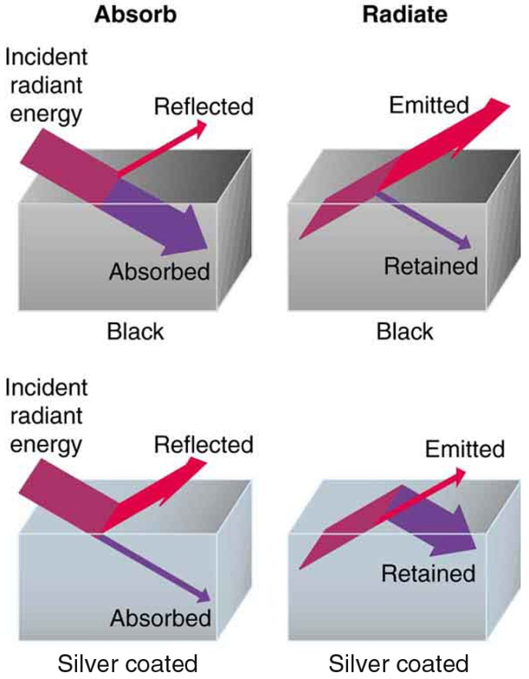
iv. Surface finishes (Applying light coloured paints on walls):
Surface colour and finish plays an important role in heat gain and loss from a structure.
If external surface of a building is painted with light colour, it will reflect solar radiation.
But if the emissivity of the surface colour in the long wave region is also high, the heat flux into the building is considerably reduced.
For example, whitewash has a lower reflectivity than aluminium, but will stay cooler when exposed to high solar radiation, due to its high emissivity at low temperatures.

Slide 25
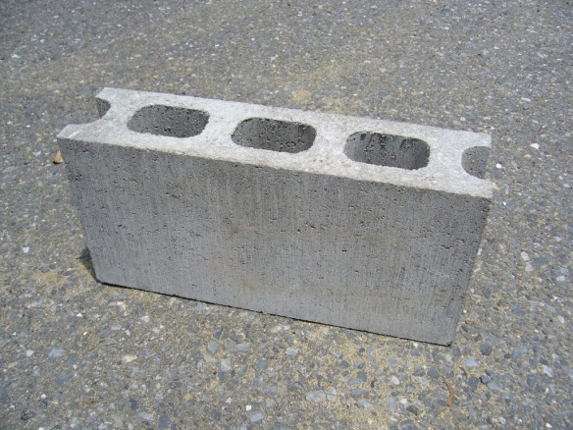
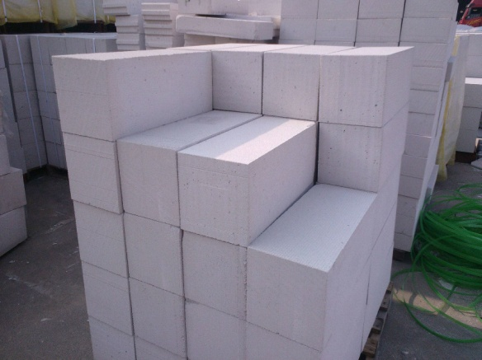
Commonly used masonry blocks: A systematic arrangement of building blocks/units is called as Masonry
Solid and hollow concrete blocks:
Hollow concrete block masonry uses lesser concrete as compared to solid concrete blocks and provides better thermal insulation due to cavity.
Filling of the cores with concrete or concrete with steel reinforcement offers much greater tensile and lateral strength to structures, wherever required.
Autoclaved cellular (aerated) concrete blocks:
These are made by mixing fly- ash, lime, cement and gypsum, with foaming agent like aluminium powder which gives them the lightweight and good insulation property.
These are lightweight blocks which can be useful to reduce dead load on structure, particularly of high rise buildings.

Slide 26
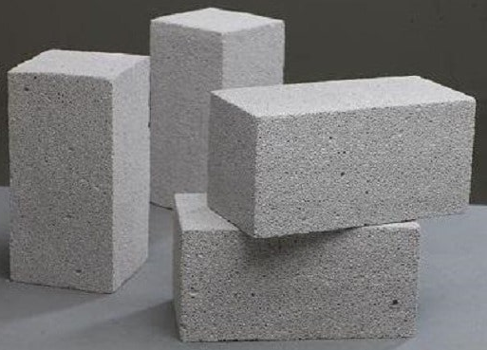
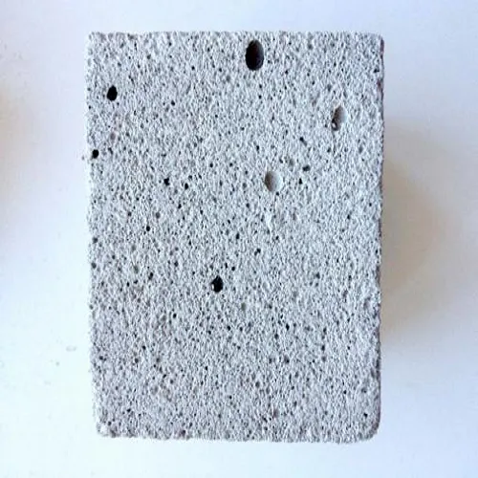
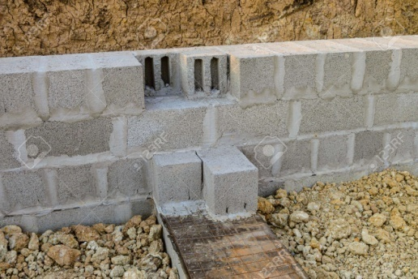
3) Lightweight concrete blocks .
These blocks are lightweight and manufactured like normal concrete blocks using light weight aggregates.
4) Preformed foam cellular concrete blocks .
These have considerably better thermal insulation properties than normal bricks or concrete.
5) Concrete stone masonry blocks:
Precast concrete stone block masonry which uses recycled stone is a viable option.
It can be made with waste stone pieces which could be locally available, and lean cement concrete

Slide 27
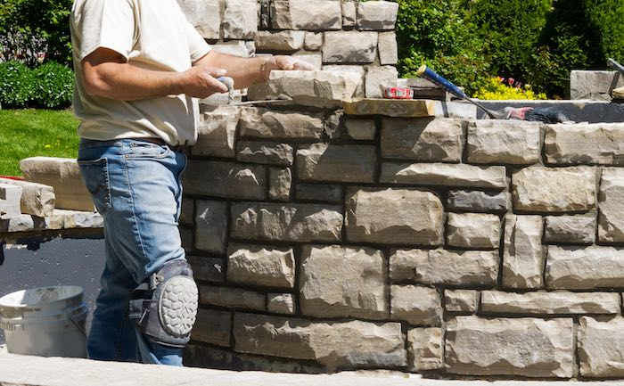
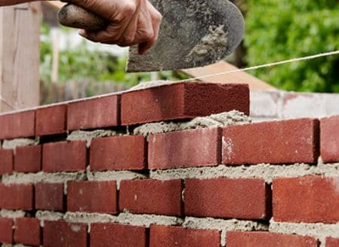
6) Stone Masonry:
This is the craft of building structures by stacking stone upon stone, using mortar (a mixture of sand, cement, and water) to hold them together.
The strength and durability of stone masonry come from the natural strength of the stones and the way they are laid together.
7) Brick Masonry:
This is the craft of building structures by laying bricks one on top of the other, again using mortar to hold them together.
Bricks are man-made rectangular units, typically made of clay that's been shaped and then baked (or "fired") in a kiln. They're uniform in size, which makes them easy to stack in an orderly manner

Slide 28
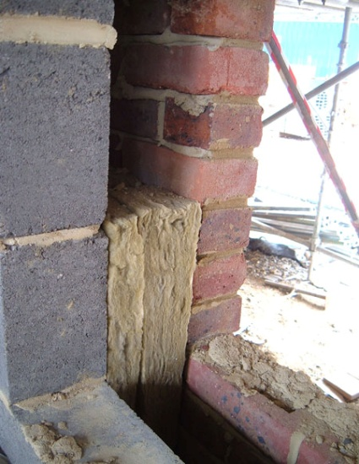
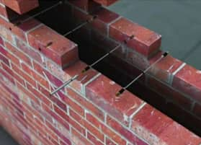
Ecological Walling System:
1. Cavity wall insulation:
Cavity wall consists of two layers of masonry separated by a hollow space that work as a thermal insulation as well as provide better sound insulation.
Cavity wall made with fly ash blended cement concrete blocks or blocks with high recycled content or internal wall with under burnt clay bricks makes it more environmental friendly.
Hollow space between the two walls can be filled with the insulation materials.
Rat trap bond is a cavity wall construction technique with added advantage of economy in brick use (of about 25 percent).
However, these walls will occupy the more floor area.

Slide 29
S.No | Type of wall | Materials | Technique | Benefits
2. | Adobe Walls | Clay, sand, straw & water | Adobe bricks are sun-dried or kiln-fired | Good thermal mass, natural insulation, biodegradable
3. | Straw Bale Walls | Straw bales, natural plaster or clay | Tightly packed straw bales held together with natural plaster or clay | High insulation, renewable, locally sourced, reduce energy consumption for heating & cooling.
4. | Cob Walls | Clay, sand, straw & water | Applied in layers directly onto the wall | Energy-efficient, non-toxic, durable, regulate indoor humidity.
5. | Rammed Earth Walls | Earth, chalk, lime or cement | Materials are compacted in layers using manual or mechanical tools. | Excellent thermal mass, durable, fire-resistant, can last for centuries.
6. | Hempcrete Walls | Hemp fibers, lime, and water | It's cast into walls, and over time, the material petrifies, becoming stronger. | Lightweight, good insulation, carbon-negative due to the hemp's ability to sequester carbon.
7. | Recycled Material Walls | Recycled materials like reclaimed wood, glass, or metal. | Salvaged materials are creatively repurposed into wall construction. | Reduce waste, save resources, and add unique character to buildings.

Slide 30
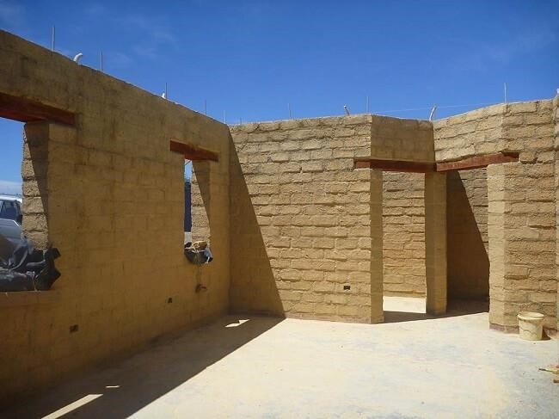
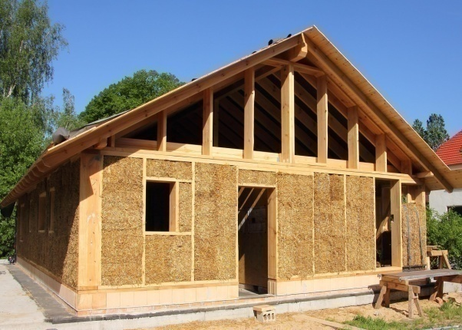
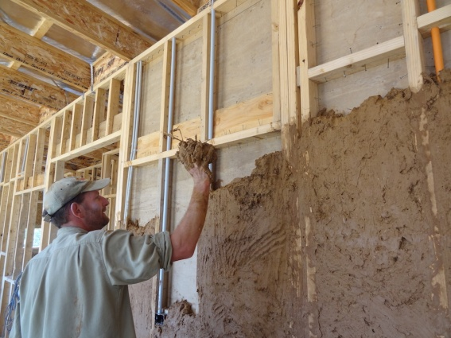
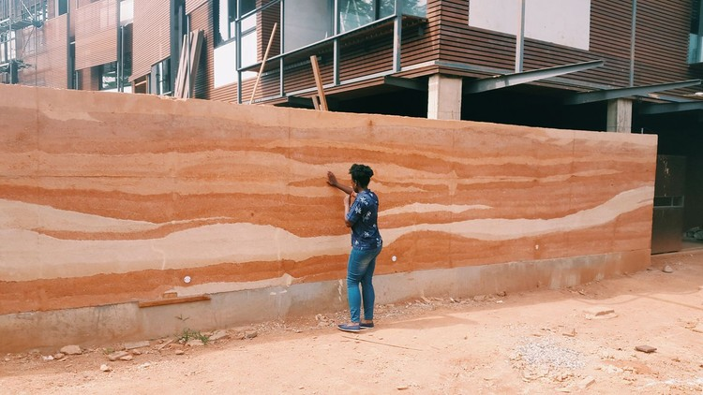
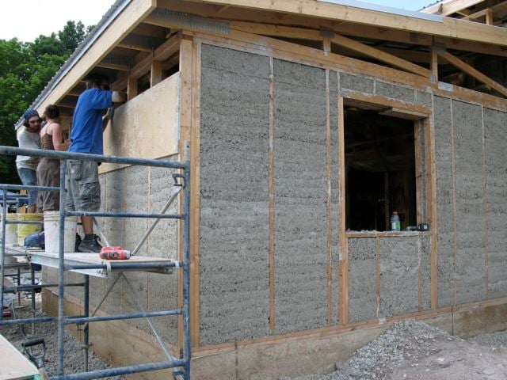
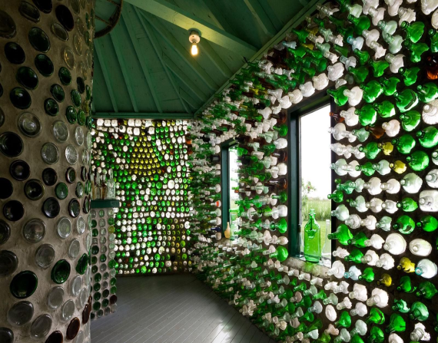
Adobe wall Straw Bale wall Cob wall
Rammed Earth wall Hempcrete wall Recycled material wall

Slide 31
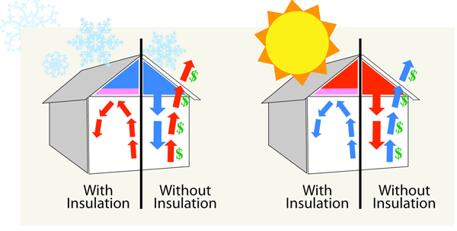
c) ROOFS AND FLOORS
Roofs of buildings receive most of heat throughout the day
In urban areas reinforced cement concrete (RCC) is used as the roofing element, which has high thermal conductivity. If the roof is exposed to solar heat, the temperature inside will also rise as the day progresses.
When roof is exposed to solar heat, it will allow continuous heat inside the building which rises the air conditioning load.
This can be controlled by roof insulation, the function of roof insulation is to insulate the building against heat inflow from outside during the day.
The overall thermal transmittance from the exposed roof should be kept as minimum as possible and under normal conditions, the desirable value should not exceed 0.58 W/(m²°C).
The ceiling surface of floors which are not to be air conditioned may be suitably insulated to give an overall thermal transmittance not exceeding 1.16 W/(m²°C).

Slide 32
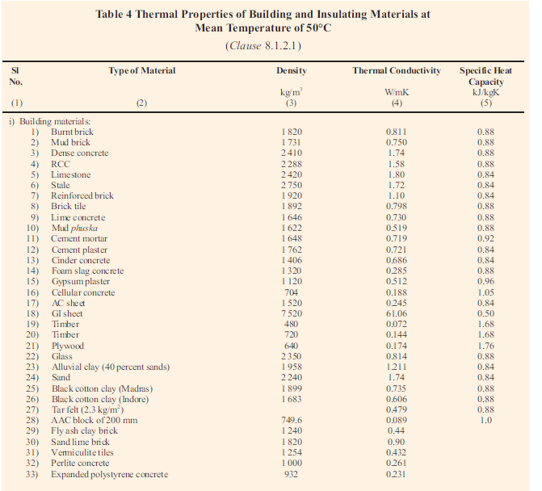
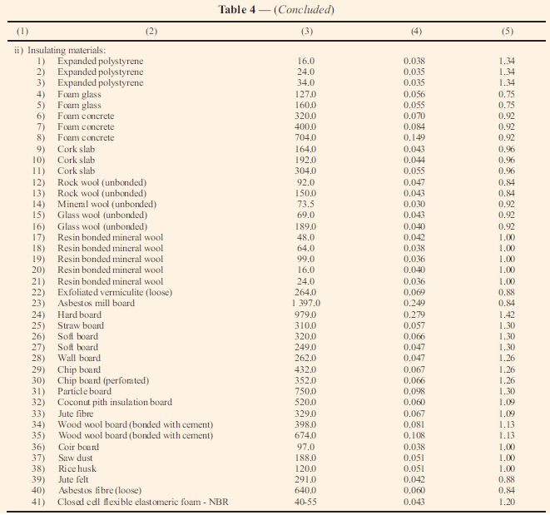

Slide 33
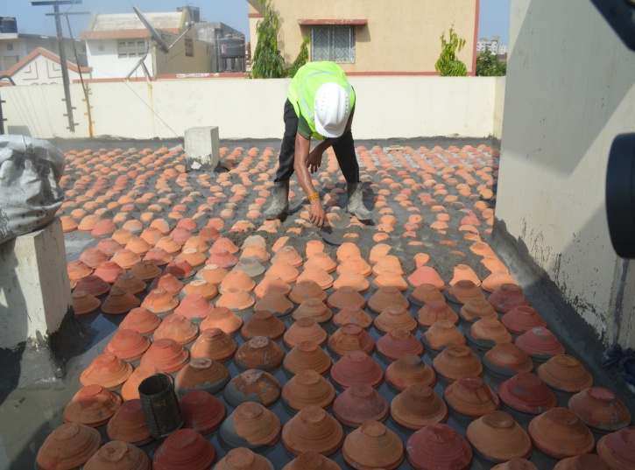
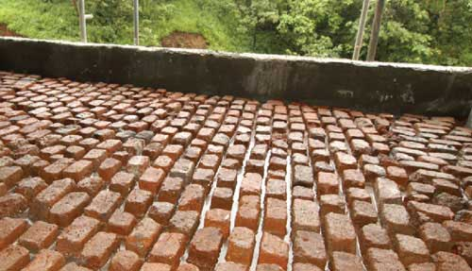
ENERGY EFFICIENT ROOF AND FLOORS:
Inverted Earthen pot:
In this method roof is covered by inverted earthen pots, the top of earthen pot can be covered with a layer of earth or lime mortar finish or can be left uncovered.
By virtue of air trapped within them they provide good insulation. Earthen pots painted with white paints further reduce the heat load.
Pots made with earth are recyclable and locally/ regionally available.
Brick bat coba:
This system involves laying mortar with broken brick (which may be waste brick pieces) as aggregates and ground brick with lime or cement as binding matrix.
A thick mass of brick bats provide the thermal insulation for roof of the building.

Slide 34
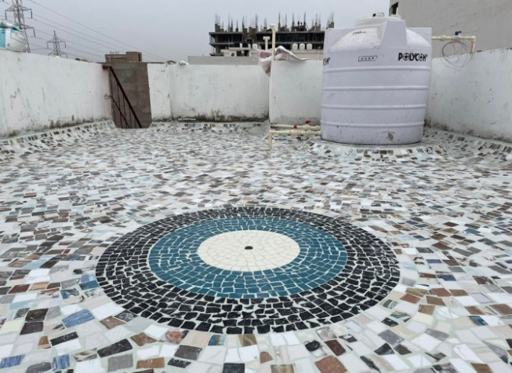
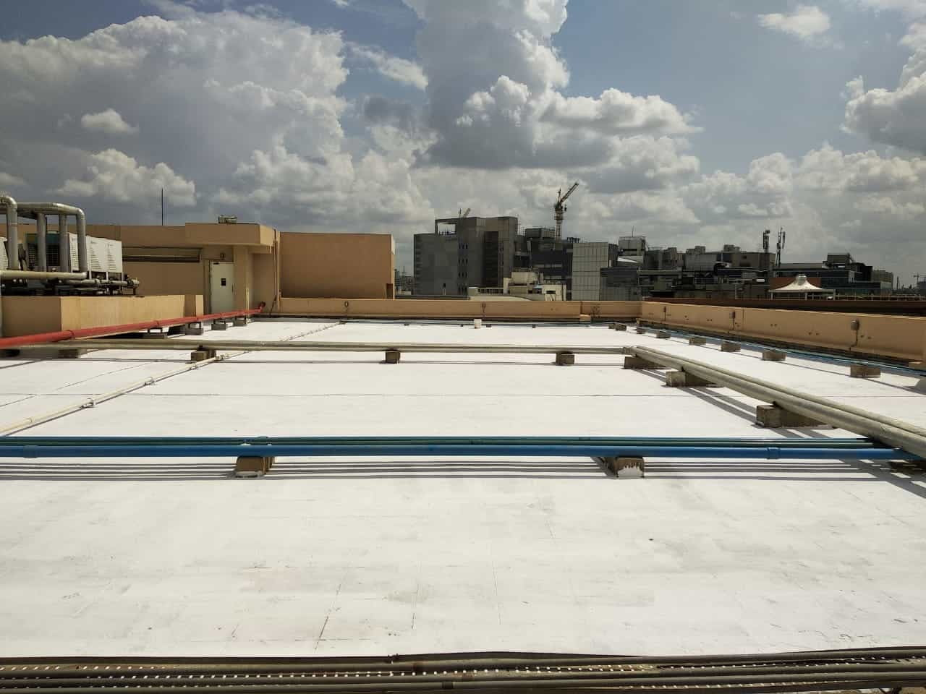
Broken ceramic mosaic tiles:
Broken ceramic tiles can be used as a cost effective external roof finish to reflect the incident solar radiation on roof.
Broken ceramic light-coloured tiles reflect heat off the surface because of high solar reflectivity and effectively utilize the waste ceramic tiles.
High SRI (Solar Reflective Index) Paints:
In recent development high thermal reflective paints are used for the exposed terrace areas which reflects incident heat and adds to the insulation values.
A roof which has received 2 coats of solar reflective paint will have a much lower surface temperature than one which has not had solar reflective paint applied.

Slide 35
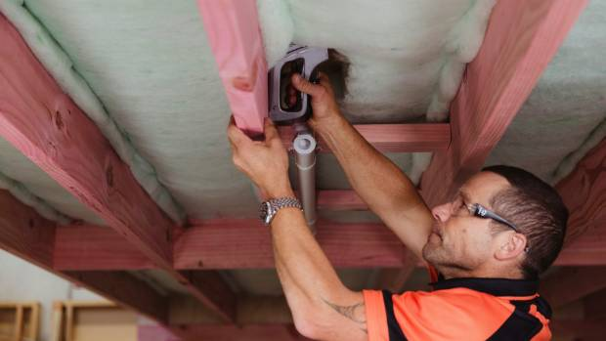
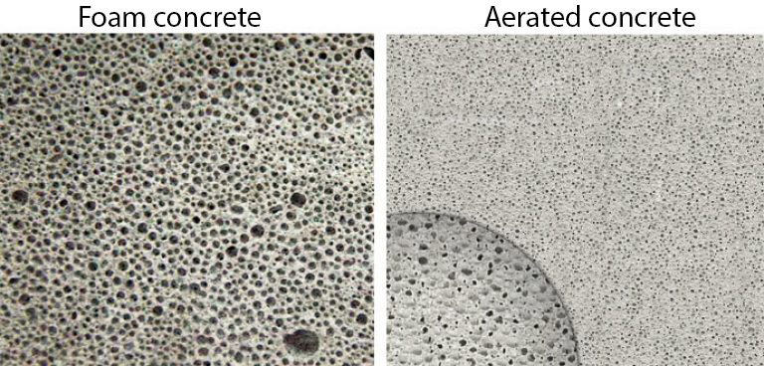
Underfloor Insulation:
It acts as a barrier, preventing cold air from seeping up from the ground or unheated spaces into living areas.
By placing insulating materials like rigid foam board or batt insulation beneath floors, homes can retain heat more effectively, enhancing energy efficiency, reducing heating costs, and increasing overall comfort during colder months.
USE OF LIGHT WEIGHT CONCRETE:
Preformed foam concrete: Preformed foam concrete may be considered for use for the leveling of floors, sprayed onto horizontal surfaces or in hollow cavities as light weight filler.

Slide 36
TYPES OF THERMAL INSULATION MATERIALS
Insulation materials may be divided into organic and non-organic groups (mineral fibres, glass wool, perlites) according to their raw materials.
Organic materials can be subdivided into more environmental friendly for example natural materials (cork, cotton and wool) and less environment friendly for example synthetic materials (polyurethane rigid foam and polystyrene).
Some thermal insulation material may be reflective and some high in embodied energy, which may get offset by saving in the operational energy of the building over their life span.

Slide 37
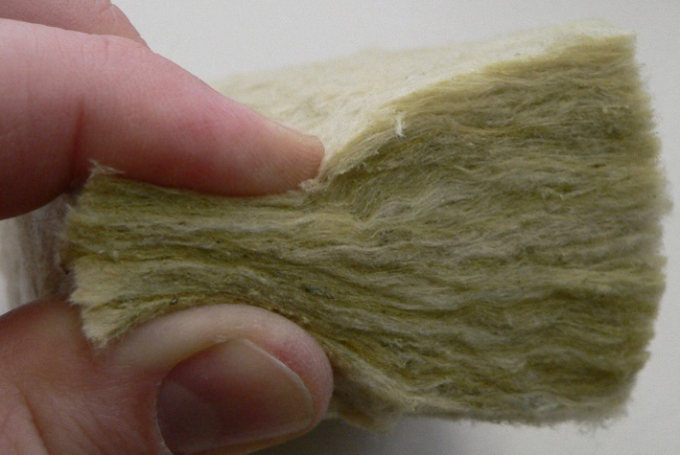
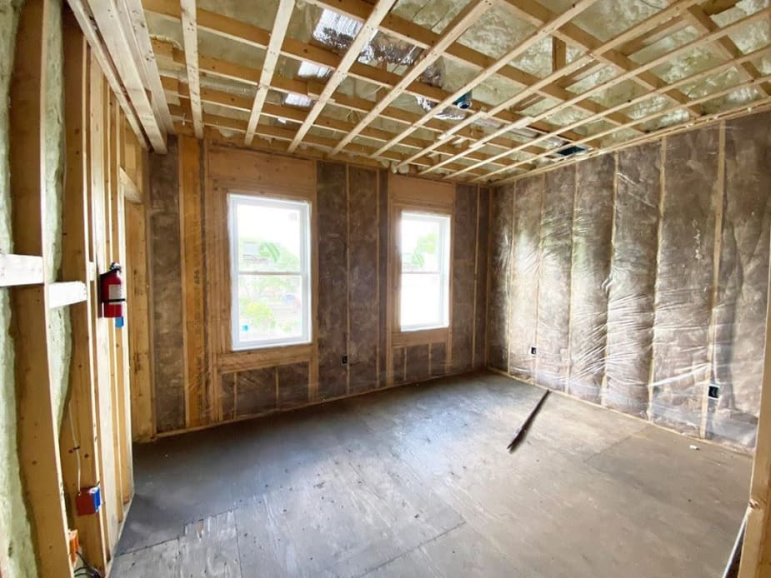
Mineral wool:
Mineral wool products are light and have extremely good thermal insulation values.
When used as insulation both glass and rock wool need a barrier of suitable material sheeting, partly to avoid dust and partly because the material cannot regulate moisture as required.
Exposure to mineral wool fibres may cause skin problems, itching, eye damage and respiratory irritation.
Examples: Glass wool, Rock wool, Cotton and Natural wool.

Slide 38
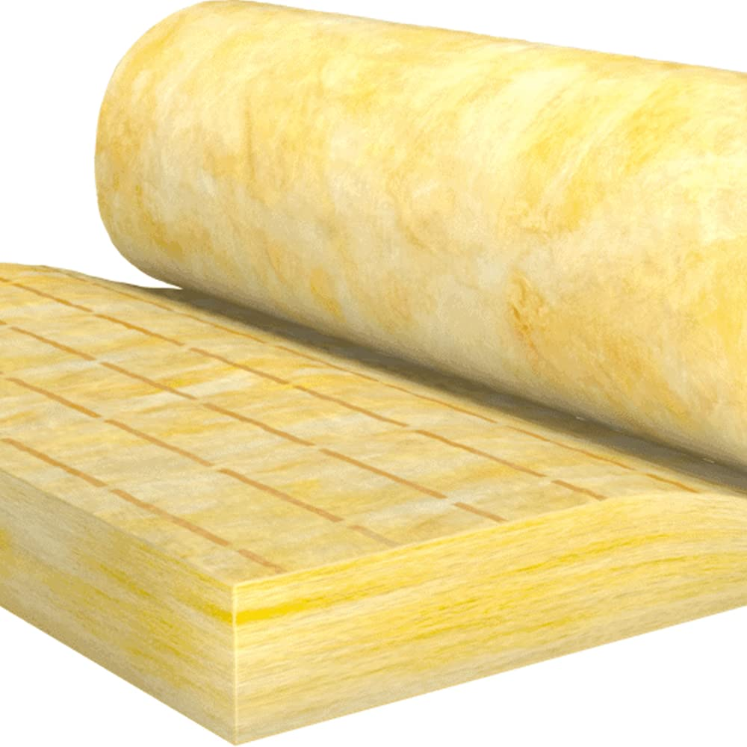

1. Glass wool:
Made from silica sand, limestone, boron, recycled glass (approximately 70 percent), phenol formaldehyde resin or acrylic resin,
it is a lightweight and fire resistant insulation material commonly used for duct and wall insulation.
Glass wool is a high embodied energy product as glass is melted at higher temperature to make the fibre.
Glass wool is easily recyclable and possesses good acoustic insulation properties.

Slide 39

2. Rock wool:
It is a light weight high embodied energy and fire resistant product, made from natural rock basalt primarily under high heat.
It is denser than glass wool and R-value is higher than glass wool.
Rock wool may contain 10 percent recycled content in the form of building waste and 15 percent recycled content from waste from industry (slag from the steel production process).

Slide 40

3. Cotton:
This is a rapidly renewable product made from both natural fibres as well as industrial waste from recycled cotton textiles.
Cotton is also a good sound insulator, requires little energy to manufacture as well as is non-toxic.
Waste cotton, a high water absorbing material should be protected by moisture/vapour barrier.

Slide 41

4. Natural wool:
It is made with recyclable and renewable source and is non-toxic and bio-degradable.
It does not contain any synthetic fibres but has a disadvantage that it absorbs VOC.

Slide 42

Cellulose fibres:
These can have very high recycled content and can be made from waste papers (about 90 percent recycled papers) or pulverized pulp and are cost-effective.
They can also be made from different types of cellulosic materials like card boards, waste papers, old newspapers, cotton, straw, saw dust and hemp.
These fibres have very low embodied energy, but they need to be treated for fire retardance (such as by boric acid).
This product may be reused and recycled but should not be incinerated.

Slide 43
Plastic:
Many plastics have good water- proofing and high thermal insulation properties (when produced as foam).
As a sealant, plastic can take many forms such as paint, sheeting, paper, sealing strips and mastics.
The materials are foamed up using chlorofluorocarbons and carbon dioxide, and fire retardants and stabilizers are added.
It is recommended to use products which do not use CFCs or HCFCs as blowing agents during manufacturing.

Slide 44



Properties of polystyrene are as follows:
Extruded polystyrene:
This material has very high R-value per unit thickness, good moisture resistance, and high compressive strength and is light in weight. It is commonly used in wall and roof insulation.
Expanded polystyrene:
It is a light weight and has high R-value, but it has low compressive strength and is not moisture resistant.
Closed cell flexible elastomeric foams:
These naturally resist ingress of water vapour, help in long term efficiency of the insulation and minimise chances of condensation and increased heat gain over a period of time.

Slide 45

Reflective Insulation materials:
These comprise highly reflective materials like aluminium foil. It may retard the heat transfer up to 97 percent. It is very effective in warmer climates, requires less area, acts as a vapour barrier also, and is non-toxic.
However, it has less compressive strength and requires some backing support.

Slide 46

Perlite and pumice products:
Perlite is a natural glass of volcanic origin.
It is pulverized and expanded in rotating kilns at about 900°C to 1200°C, which increases its volume from five to twenty times.
It is used either as loose fill insulation or as aggregates in mortar and light weight concrete blocks.
Perlite absorbs water, hence moisture preventive materials like bitumen or silicon are sometimes added.
It can be used for thermal insulation of buildings, refrigerating rooms and high temperature insulations.

Slide 47

Vermiculite products:
Vermiculite is formed through the disintegration of mica, which liberates
lime and takes up water.
When vermiculite is heated to 800°C to 1100°C, it swells to become a light porous mass which can be used as an independent loose insulation or as an aggregate in a lightweight concrete in the proportion of 6 : 1 (vermiculite to cement).
Prefabricated slabs can be made in varying thickness from 15 mm to 100 mm using this material.
Vermiculite is useful for high temperature areas and equipment.
It easily absorbs large amount of moisture, even more than untreated perlite.
As normal wall insulation, it has a tendency to settle, hence needs to be compressed substantially after filling into the wall cavity.

Slide 48


Saw dust and wood shavings:
They are wastes from timber industry or carpentry, and can be used for thermal insulation in walls or ceilings.
Saw dust has hygroscopic property due to which it easily absorbs moisture, and then releases it in air and therefore is moisture regulating.
Saw dust and wood shavings are chemically inert, non-toxic.
However, they are not fire resistant, and the same can be improved by adding pulverized clay.

Slide 49
IMPORTANT TERMINOLOGY
Thermal Absorptivity: A factor indicating the relative amount of radiation absorbed by a surface as compared to an absorbing black body under the same conditions. Its value is dependent upon the temperature of the source and of the receiving surface.
Thermal Capacity: The amount of heat necessary to raise the temperature of a given mass by 1°C. Numerically, the thermal capacity per unit area of surface is the sum of the products of the mass per unit area of each individual material in the roof, wall or floor surface multiplied by its individual specific heat.
Thermal Conductance (R): The thermal transmission of a single layer structure per unit area divided by temperature difference between the hot and cold faces. It is expressed in W/m² K.
Thermal Comfort: That condition of mind which expresses satisfaction with the thermal environment and is assessed by subjective evaluation.
Thermal Transmission or Rate of Heat Flow (q): The quantity of heat flowing in unit time under the conditions prevailing at that time. Its unit is W.

Slide 50
Thermal Conductivity (k) : The quantity of heat in the steady state conditions
flowing in unit time through a unit area of a slab of uniform material thickness of infinite extent and of unit thickness, when unit difference of temperature is established between its faces. Its unit is W/mK.
Thermal Reflectivity: The ratio of the reflected heat to that of the total heat incident on a surface at a certain mean temperature range.
Thermal Resistance (R): The reciprocal of thermal conductance. For a structure having plane parallel faces, thermal resistance is equal to thickness (L) of the structure divided by thermal conductivity (k).
Thermal Resistivity (1/k): The reciprocal of thermal conductivity. It is expressed in mK/W.
Thermal Transmittance (U): Thermal transmission through unit area of the given building unit divided by the temperature difference between the air or other fluid on either side of the building unit in steady state conditions. It is also called as U-value. Its unit is W/m²K

